Slide 1
Peel
Council on Aging
Healthy aging for all
Notes:
PETER

Slide 2
Background
Groundwork 2015-2020
Planning 2020-2021
Implementation 2021-2022
Launch 2022-2023
Member of the Ontario Association of Councils on Aging 2023
Held the first Summit on Aging and inaugural AGM May 2023 and second 2024
Notes:
PETER

Slide 3
Groundwork
OTF Collective Impact funding
Community engagement and needs assessment
Through PEAPN Collective Impact Core Working/Steering Groups
Established Common Agenda, Theory of Change and need for Peel Council on Aging
New office space – Seniors Health & Wellness Village Agreement
2015-20
Notes:
PETER
In 2015, PEAPN received funding from the Ontario Trillium Foundation to investigate how system navigation could be improved to ensure Peel older adults have better access to the programs and services available. PEAPN conducted surveys and focus groups where they heard from both individuals and service providers, that an organization was needed to facilitate the region-wide conversation. This was a five-year process that laid the groundwork for the Peel Council on Aging.

Slide 4
Planning
Region of Peel Organizational Effectiveness funding
Explored best practices from the 11 Councils on Aging in Ontario
Developed the PCoA Terms of Reference and By-laws
Conducted community engagement to confirm the proposed PCoA structure and governance
Became incorporated
2020-21
Notes:
PETER
In 2019, Peel Senior Link became the lead agency of the Peel Council on Aging and received Region of Peel Organizational Effectiveness funding to develop the PCoA Terms of Reference and By-laws. We explored best practices from the 11 Councils on Aging in Ontario to determine what would work for Peel. In 2020, we took the draft PCoA structure back to the community to confirm our direction and we received their support. In 2021, Peel Council on Aging recruited an inaugural Board of Directors and became incorporated.
RAY explain role of PSL as the lead organization

Slide 5
Vision
Healthy aging for all
in a connected and caring community
Notes:
PETER

Slide 6
Mission
The Peel Council on Aging will advance positive aging by promoting the health, well-being and social participation of Peel older adults and by influencing attitudes, policies and programs to include the voices of all older persons.
Notes:
PETER

Slide 7
Mandate
The Peel Council on Aging will:
serve as a cross sectoral collective of community members and groups who come together to drive collective impact in alignment with regional priorities related to healthy aging and older adults
provide leadership, foster community connections, and lend support across senior sector organizations
build capacity by supporting organizations whose primary role it is to deliver programs
support equity seeking groups with respect to healthy aging
Page 1 of 2
Notes:
PETER

Slide 8
Mandate
optimize the efficiency and effectiveness of system navigation and service delivery in the region
influence decision-makers and contribute to policy development as related to healthy aging
support age-friendly communities and promote healthy aging
build awareness about the importance of a connected and caring community
Notes:
PETER

Slide 9
Values
Collaboration – We will engage cross sectoral stakeholders to create synergies and align Peel Council on Aging projects with existing plans.
Diversity – We respect each person has unique needs and we will foster community engagement by including the many voices of Peel older adults.
Respect – We will act with integrity and with ethical responsibility.
Notes:
PETER

Slide 10
PCoA provides the connection
for regional collaboration
Notes:
RAY
PCoA will collaborate with the region and each municipality to assist with the actions outlined in their Age-friendly Plans. We will provide the opportunity for the region and municipalities to partner on projects and share best practices. The PCoA mission and mandate speak to how this will be done to ensure we achieve our vision for Peel to be a connected and caring community.

Slide 11
Peel Council on Aging Structure
Board of Directors
Housing Roundtable
Healthy Aging
Roundtable
Safety Roundtable
Staying Mobile
Roundtable
Building Community Roundtable
Steering Committee
Chair and
Vice of
Board of
Directors
and each
Round Table
Notes:
RAY
Board of Directors
President, Vice, Secretary, Treasurer, and Communications, Membership Recruitment Officers
Backbone of the organization
Guides and approves strategy
Mobilizes resources (fundraising, grant application)
Provides administrative and financial oversight
Supports Steering Committee and Roundtables
Advances policy
Steering Committee
Two members representing the Board of Directors and each Roundtable
Accountable to the Board of Directors
Meet to share Roundtable and Board updates
Be a conduit of information through two-way communication
Roundtables
Provide partner-driven action
Community partners and volunteers from stakeholders, organizations or individuals with expertise, and commitment who take an active role in the work of implementing the strategies
Cross-sectorial representation, geography (Mississauga, Brampton, Caledon), diversity (ethno-cultural, LGBTQ+), lived experience (seniors), community/not-for-profit/for-profit/education/government
Sharing and building alignment; collaboration
Providing organization project updates to increase communication and partnerships

Slide 12
Board of Directors
Myrna Adams Board Chair
Peter Howarth Treasurer
Ray Applebaum Secretary
Sandeep Dhupar Director
Donna Kern Director
Ann Murphy Director
Provide project support
Apply for charitable status
Organize AGM for spring 2023
Develop election procedures
Notes:
RAY
In 2022/23, the role of the Board was to
Provide Roundtable support
Apply for charitable status
Organize AGM in spring 2023
Develop election procedures

Slide 13
Housing
Roundtable
Identify and promote next step living options that support and address Peel older adult financial, social, and physical housing needs
Notes:
RAY
The goal of the Housing Round Table is to identify and promote next step living options that support and address Peel older adult financial, social, and physical housing needs.

Slide 14
Healthy Aging
Roundtable
Support opportunities for healthy choices that enhance independence and quality of life and connect Peel older adults
with services that assist them
Notes:
RAY
The goal of the Healthy Aging Round Table is to support opportunities for healthy choices that enhance independence and quality of life and connect Peel older adults with services that assist them

Slide 15
Safety
Roundtable
Raise awareness of safety issues so Peel older adults can recognize the risks of harm and respond with appropriate actions
Notes:
RAY
The goal of the Safety Round Table is to raise awareness of seniors’ safety issues so Peel older adults can recognize the risks of harm and
respond with appropriate actions

Slide 16
Building Community
Roundtable
Empower Peel older adults to be engaged in their community through civic engagement and volunteerism, social and physical participation, and lifelong
learning opportunities
Notes:
RAY
The goal of the Building Community Round Table is to empower Peel older adults to be engaged in their community through civic engagement and volunteerism, social and physical participation, and lifelong learning opportunities

Slide 17
Staying Mobile
Roundtable
Establish safe, active transportation through connected communities and promote age-friendly rural and urban transportation options in Peel
Notes:
RAY
The goal of the Staying Mobile Round Table is to establish safe, active transportation through connected communities and promote age-friendly rural and urban transportation options in Peel.

Slide 18
PCoA Membership
Not-for-profit organizations
Senior serving businesses
Government
Research and academia
Health care professionals
Community members
Notes:
RAY
PCoA members are older adults interested in making a difference and organizations that support older adults. Membership is open an inclusive to all. The voice of older persons is integral to the work of PCoA.
Our common is agenda is to create a connected and caring age-friendly community.

Slide 19
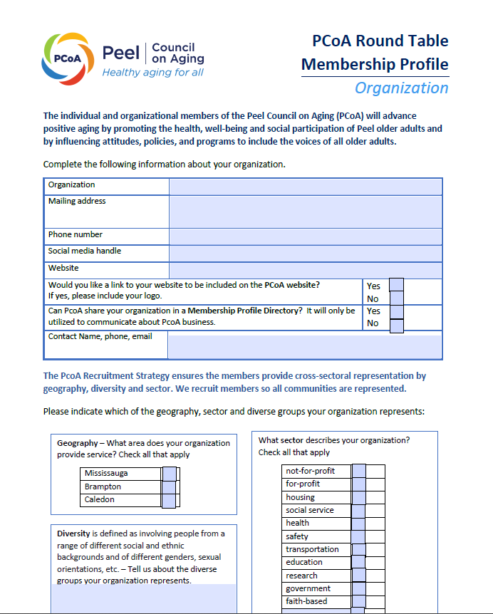
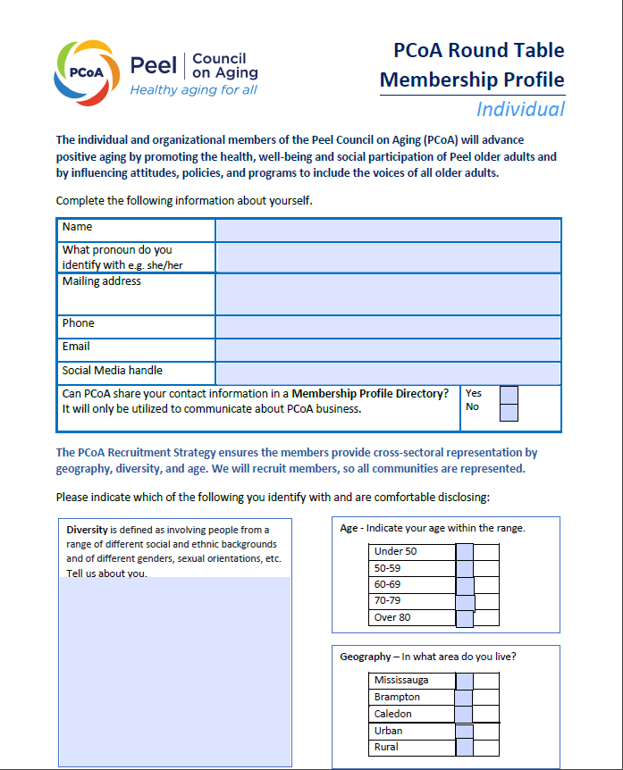
PCoA Membership
Notes:
RAY
Membership to PCoA is free.
Each person who would like to be a PCoA member, completes an Individual Membership Profile.
If you are representing an organization, only one person completes an Organization Membership Profile.
Any changes to your Membership Profile are submitted to the Membership & Recruitment Officer.

Slide 20
PCoA Membership
The role of PCoA members is to be committed to and support PCoA Vision, Mission and Mandate. Members will:
be a positive advocate and promote PCoA
participate in meeting discussions
provide letters of support for funding
be actively involved in PCoA projects and/or events
Notes:
RAY
ROLES AND RESPONSIBILITIES OF members
The role of PCoA members is to be committed to and support PCoA Vision, Mission and Mandate. Members will:
understand the aims and objectives of PCoA and be a positive advocate
act as the liaison with their community/agency, maintain two-way communication and promote PCoA
participate in meeting discussions. Meetings are held bi-monthly and it is up to each Roundtable to decide if the meetings are in-person and the location
provide letters of support for funding
be actively involved in PCoA projects and/or events

Slide 21
Implementation
Region of Peel Change Fund
Conduct a survey to determine how COVID-19 has affected older adults
Identify and align stakeholders and projects with the 5 PCoA domains
Implement a Communication Strategy that includes internal and external tools
2021-22
Notes:
RAY
In 2021, we received Region of Peel Change funding to implement the Peel Council on Aging.
We conducted a conducted a survey to determine how COVID-19 has affected older adults and are analyzing the results. The report was shared with the Roundtables. Copies are available at the PCoA table.
The Implementation project included developing a Communication Strategy that included branding, Teams as the internal communication portal, social media, and website.

Slide 22
Key Milestones
Region of Peel Change Fund
Recruited members and held Roundtable meetings
Developed the PCoA website
Organized the first annual PCoA Summit on Aging
Hired the PCoA Coordinator
2022-23
Notes:
RAY
In 2022, we received Region of Peel Change funding to launch the Peel Council on Aging.
We started to recruit members for each of the five Roundtables and held meetings in October , December, and February
We developed the PCoA website
We organized the first annual PCoA Summit on Aging
We hired the first PCoA Coordinator

Slide 23
Help Peel become
a more age-friendly
community
Get involved!
Notes:
Become involved, become a member. Help Peel become a more age-friendly community.

